Slide 1
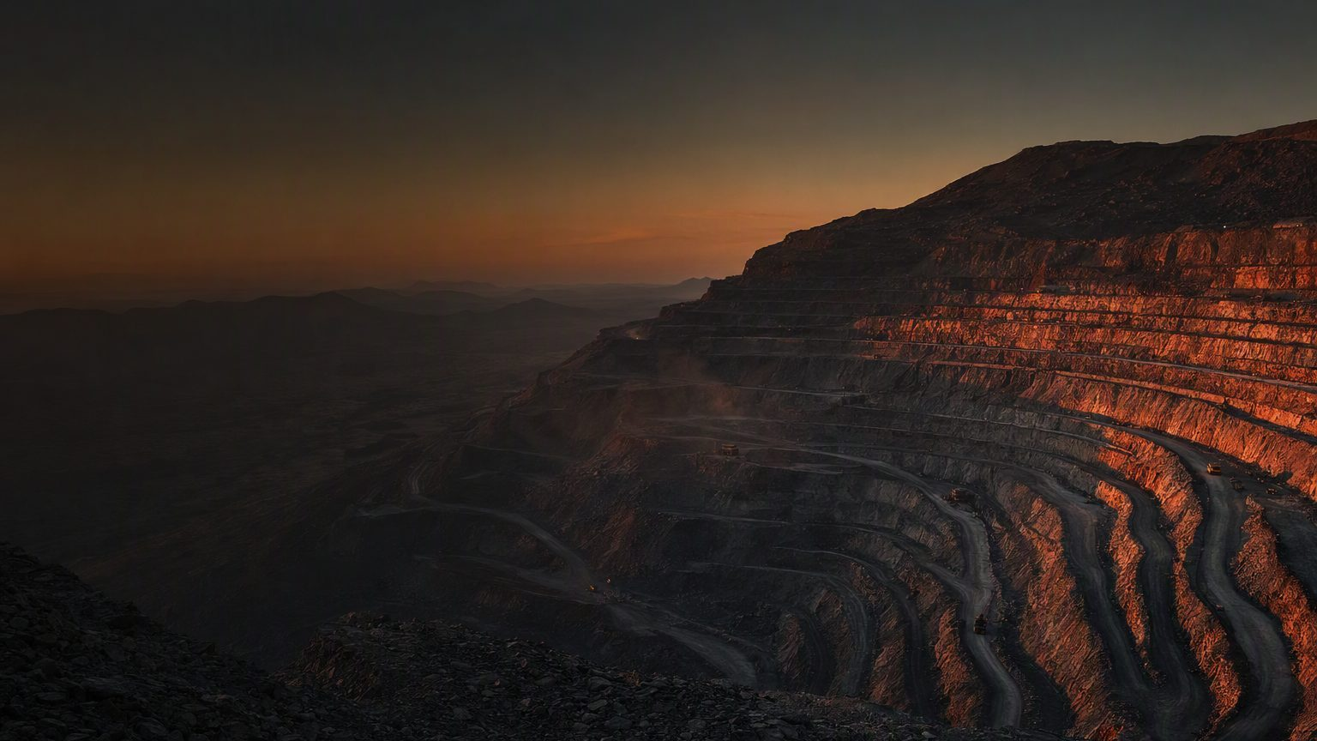
AI-POWERED GEOMETALLURGY
Geomet 360
A 360-degree view of the ore - what it is, how it will behave, and the value it can deliver.
Notes:
(~45 sec) Good morning. Every orebody is variable, and that variability decides what every tonne is worth once it reaches the plant. Geomet 360 is an AI-powered geometallurgical agent that connects what we know about the orebody to what we know about plant performance. In the next four minutes I'll show you the problem it solves, how it works, and what it means for the business. One sentence to hold on to: Geomet 360 answers the question 'How will this ore behave when it reaches the plant - and what does that mean for us?'

Slide 2
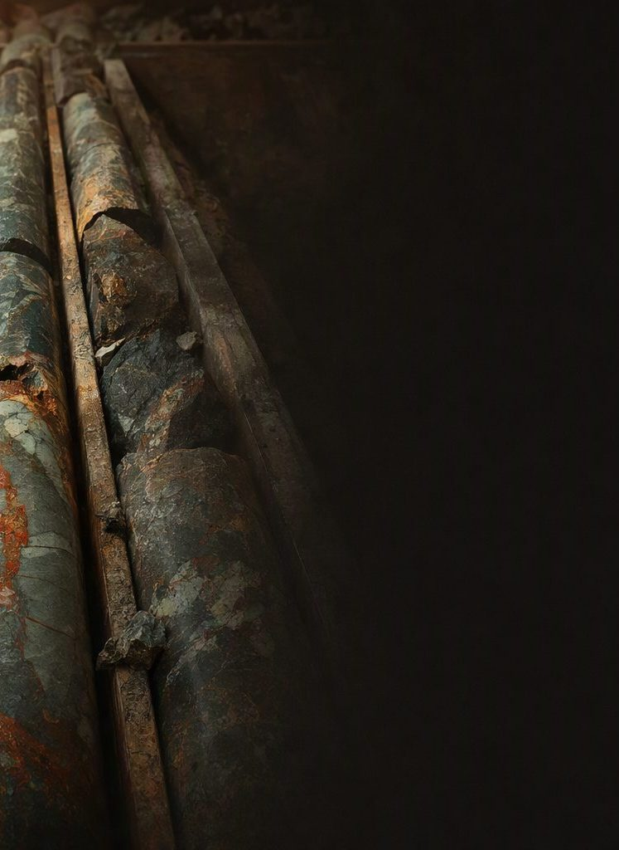
THE PROBLEM
Ore behaviour is discovered too late
Mineralogy, texture, hardness and chemistry vary
Recovery, throughput, energy and cost follow
The knowledge exists - scattered across systems
Difficult ore shows up after the loss, not before
Notes:
(~60 sec) Here is the problem. Changes in mineralogy, texture, hardness, liberation and chemistry all change how ore behaves in the plant - and that flows straight through to recovery, throughput, energy, water, operating cost and the value of every tonne. The frustrating part is that we are not short of information. Mines already generate enormous volumes of geological, mineralogical, geometallurgical and plant data. But it lives in different datasets, different systems and different disciplines, so nobody sees the whole picture. The result is reactive: we discover difficult ore after throughput has dropped or recovery has been lost.

Slide 3
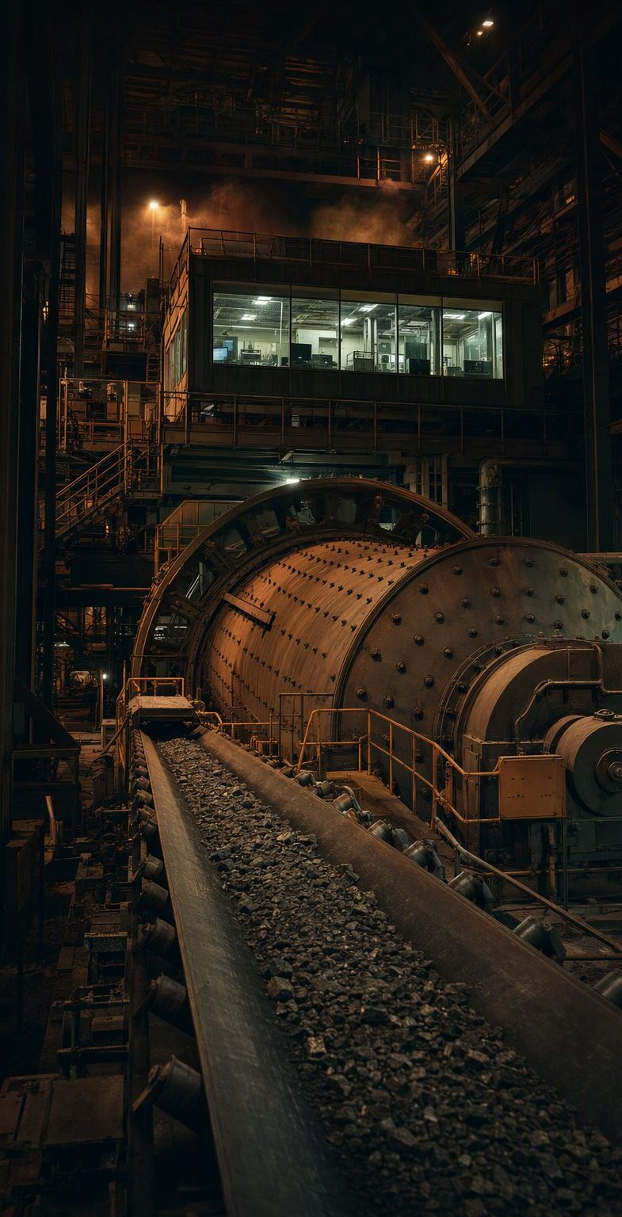
THE SOLUTION
Know the ore before it reaches the plant
CONNECT
Mineralogy, geomet data, domain knowledge and plant history
COMPARE
Finds similar material the plant has processed before
PREDICT
Expected recovery, throughput constraints and what drives them
ACT
Actions to consider before that material reaches the plant
Just ask: “Where is our processing risk next week?”
Notes:
(~75 sec) Geomet 360 creates a dynamic link between the orebody and plant performance. It connects mineralogy, ore characteristics, geometallurgical data, domain knowledge and historical processing response. It identifies similar material processed in the past, connects that to processing models, and anticipates likely behaviour: what recovery can we expect, will throughput be constrained, what is driving the response, and what could we do before that material arrives. That shifts us from reactive to proactive - mine planners, geologists and metallurgists working from one shared view of expected ore behaviour to support sequencing, blending and processing decisions. And it is conversational: you can simply ask 'Why is recovery expected to decrease?' or 'Have we processed similar material before?' and get the answer with the evidence and context behind it.

Slide 4
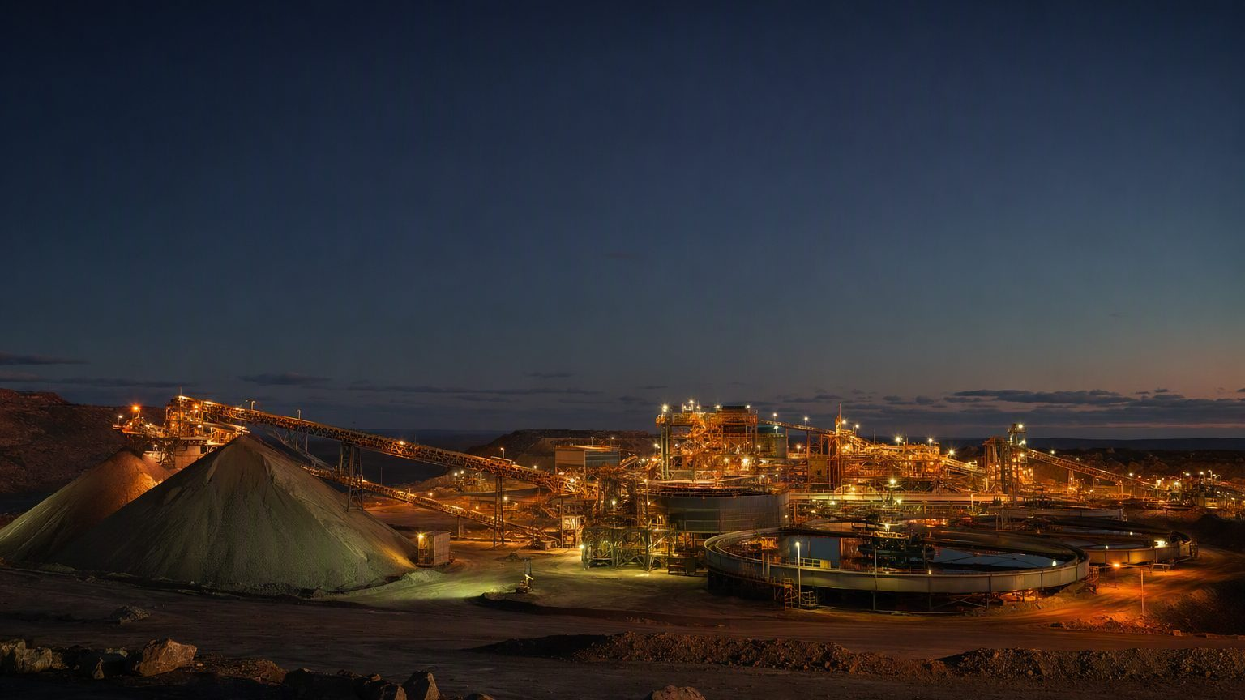
THE OPPORTUNITY
Ore knowledge, connected to business value
Stable production
Fewer throughput surprises
Protected value
Improved recovery and capacity
Leaner processing
Targeted energy and water use
Know the ore. Predict the performance. Protect the value. Geomet 360.
Notes:
(~60 sec) The business case is straightforward. More predictable feed means more stable production, improved recovery, fewer unexpected throughput losses and better use of plant capacity. Understanding ore behaviour earlier also lets us target energy, water and reagent consumption more effectively, supporting lower unit processing costs and better resource efficiency. And it compounds: as ore moves through the operation we compare predicted behaviour with actual plant performance, and that actual response becomes new knowledge - a dynamic geometallurgical model that keeps strengthening the connection between the orebody and the plant. A 360-degree view of the ore: what it is, how it will behave, what it costs to process, what value it delivers, and what we learn from the outcome. Know the ore. Predict the performance. Protect the value. Geomet 360.

